Slide 1
Wildlife Workshop
RIDEM Division of Fish & Wildlife
Mary Talbot, Senior Wildlife Biologist
Jennifer Brooks, Volunteer Coordinator

Slide 2
Using Ques and Clues to Assess Potential Species Within an Area

Slide 3
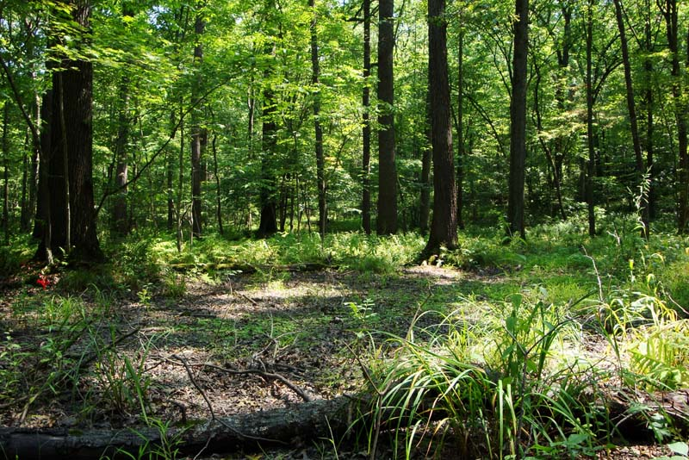
Look Around You. What Do You See?

Slide 4
Try Breaking it Down....
Plant life is an easy starting point! This helps you to figure out your habitat type, and make an educated guess as to which animals live there.
Are there trees, fields, or desert?
Ex. Trees? Shrubs? What kind?
Do any of these trees/plants produce flowers, fruits, seeds?
Which type of animals can access/extract these food sources?
Are there sources of water?
Not only for animals to drink, but what types of animals may live/breed there?
Do these water sources produce food sources as well? Larvae, eggs, fish, aquatic insects, plants, algae, etc.?
What kind of cover is available?
Thick shrubs, grasses, Logs, snags, water, trees, caves, brush piles, rock walls, buildings?
If in a forest, is there an understory? Is there an edge?

Slide 5
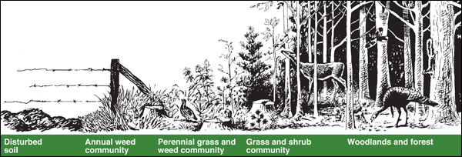
Is There Gradual Edge? Or Does the Forest End Abruptly?

Slide 6
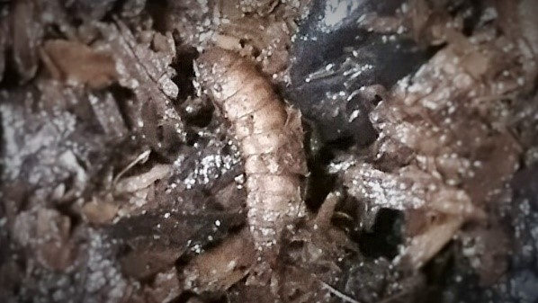
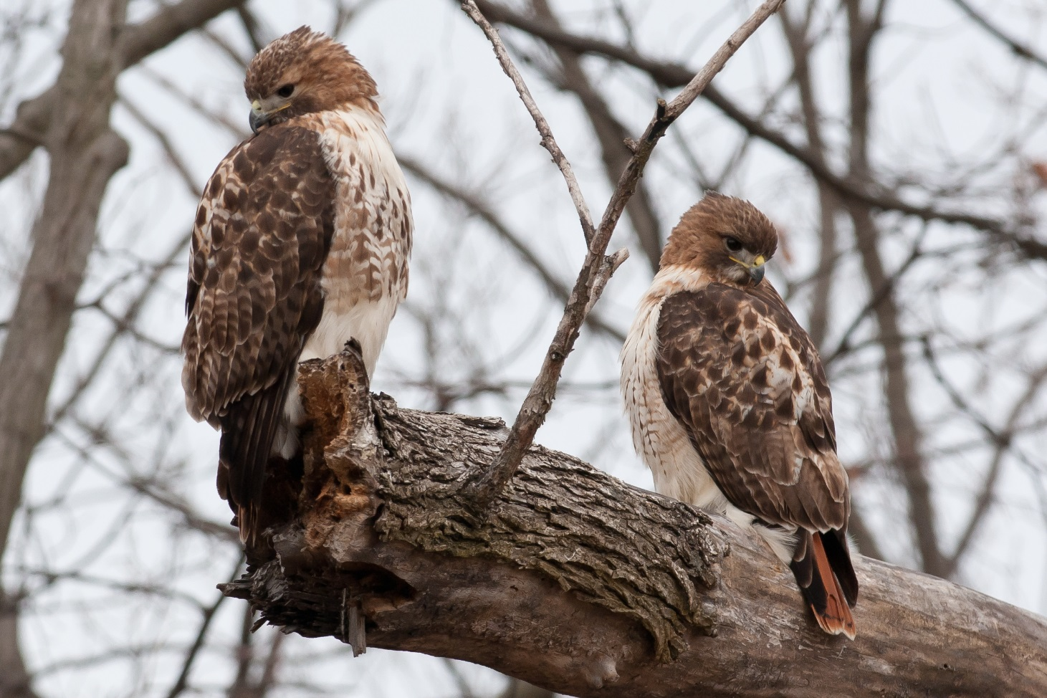
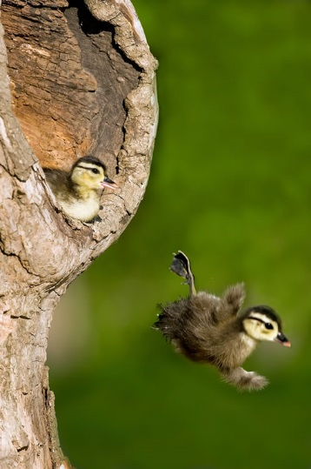
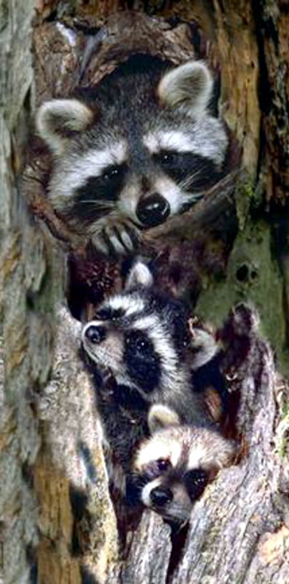
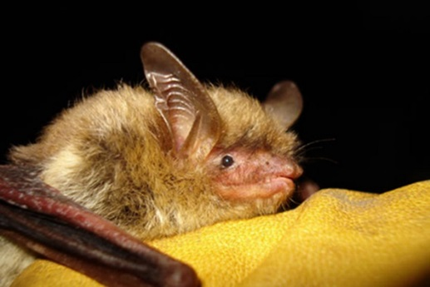
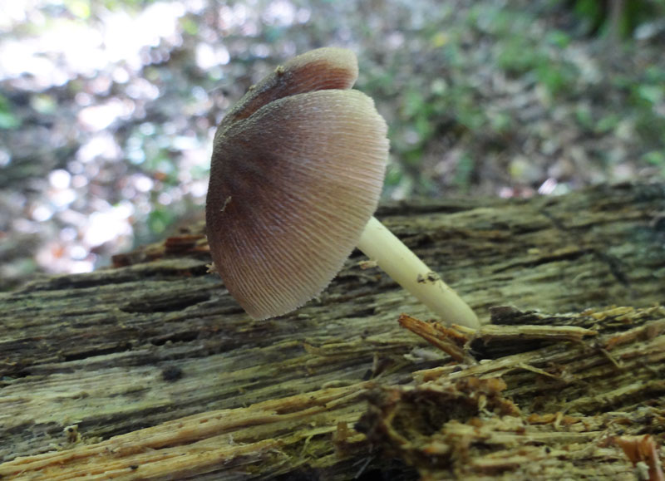
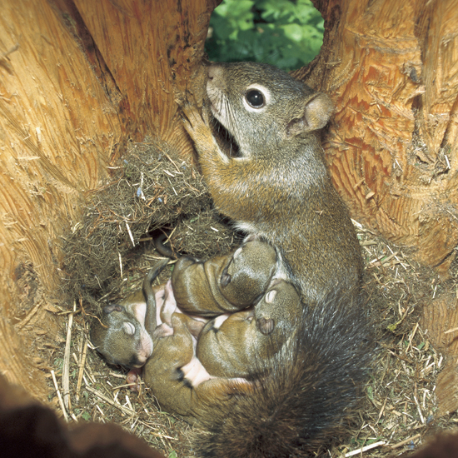
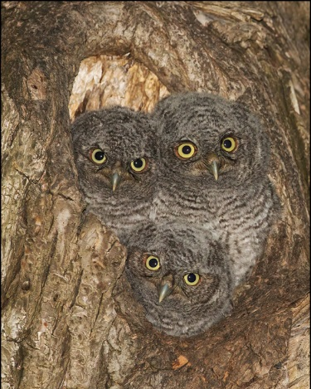
Cover: Snags and Tree Cavities
NESTING Habitat for many species!
FOOD Sources!
ROOSTING Areas!

Slide 7
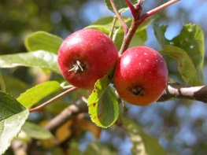
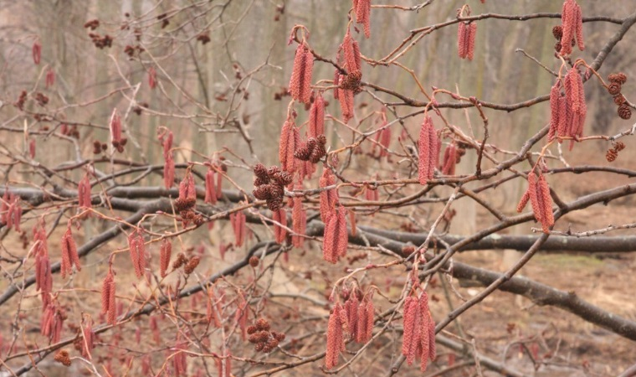
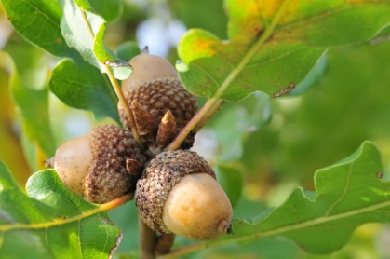
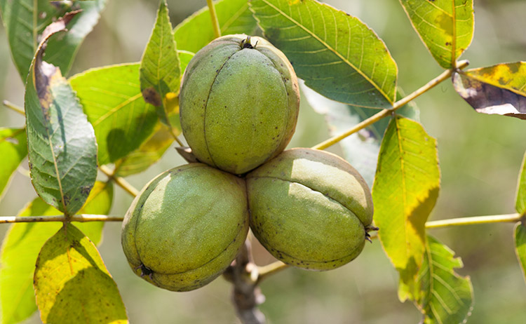
Food Sources (Examples from Plants/Trees):
Seeds: Acorns, Beech nuts, Hickory nuts, Pinecones, Grass Seeds, Catkins
Fruit: Berries, Crab Apples, Grapes
Bark/twigs
Shoots, Leaves, Buds
Fungi

Slide 8
Other Food Sources:
INSECTS
Flying: Mosquitoes, Flies, Moths
Crawling: Termites, Ants
Larva (in bark, in soil, water)
Eggs
Other Mammals, Birds, Reptiles, Amphibians
Including their eggs and/or young

Slide 9
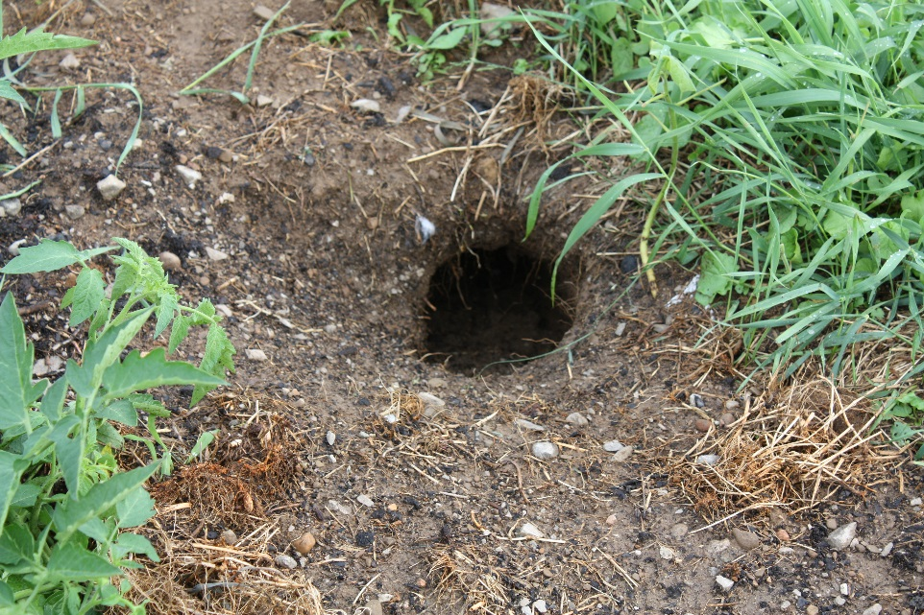
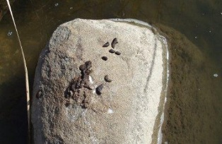
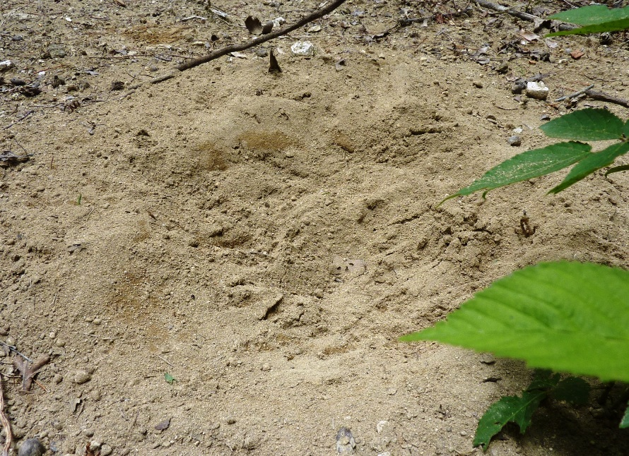
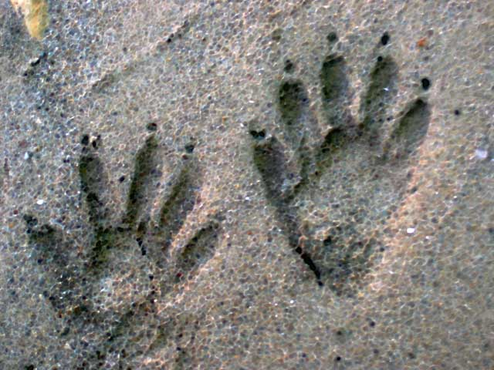
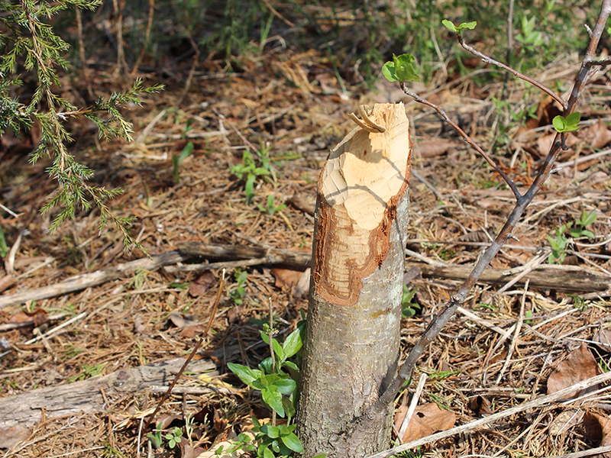
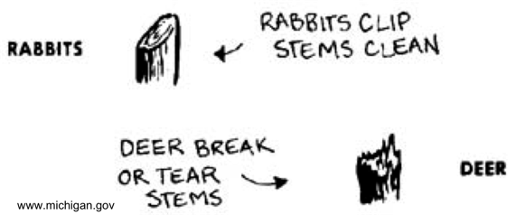
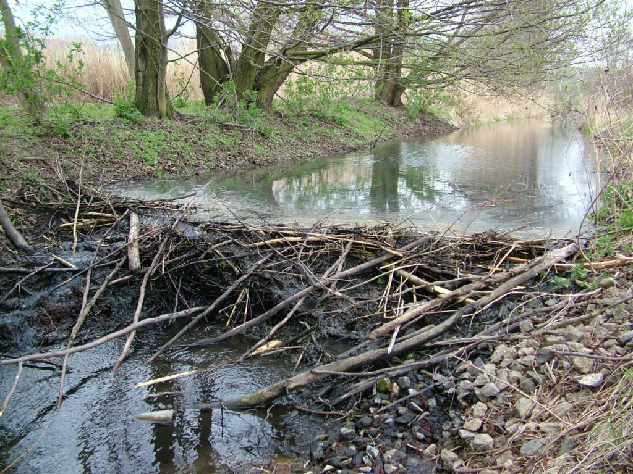
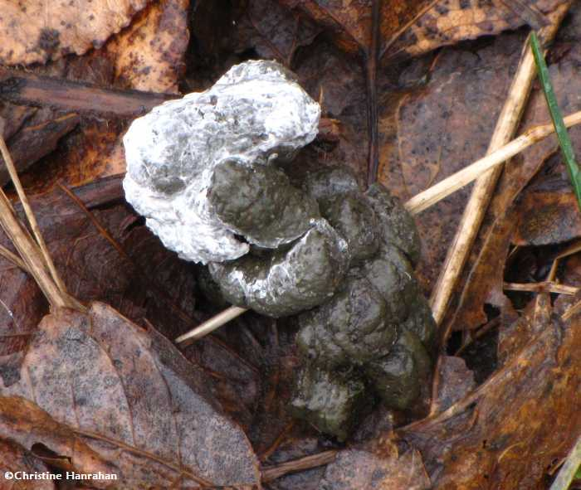
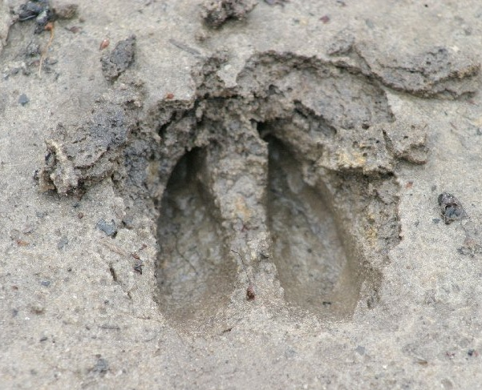
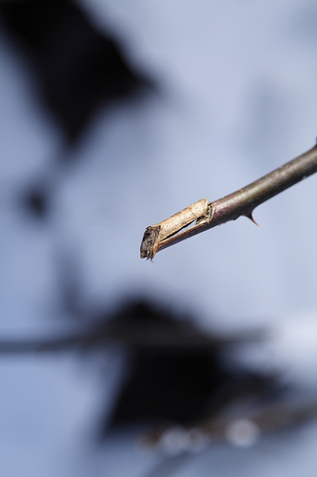
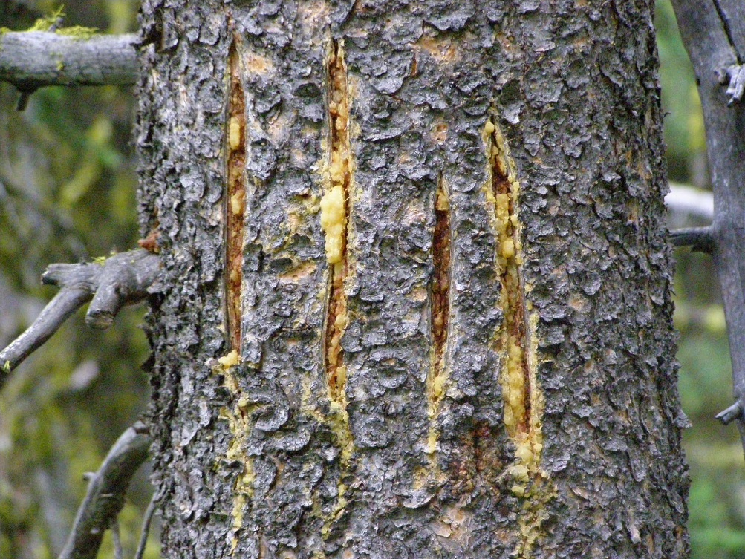
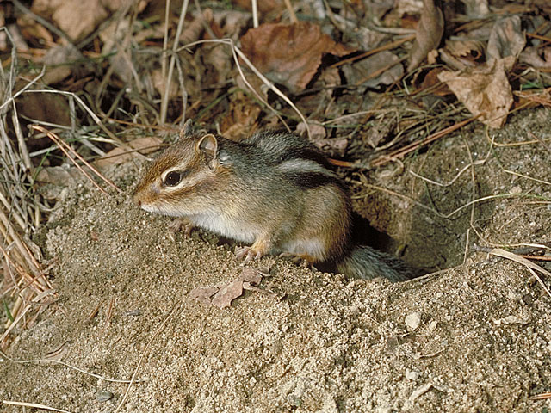
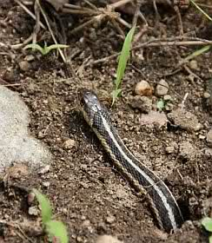
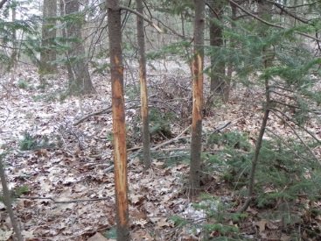
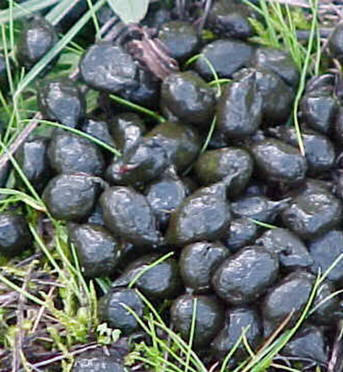
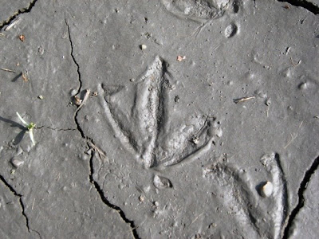
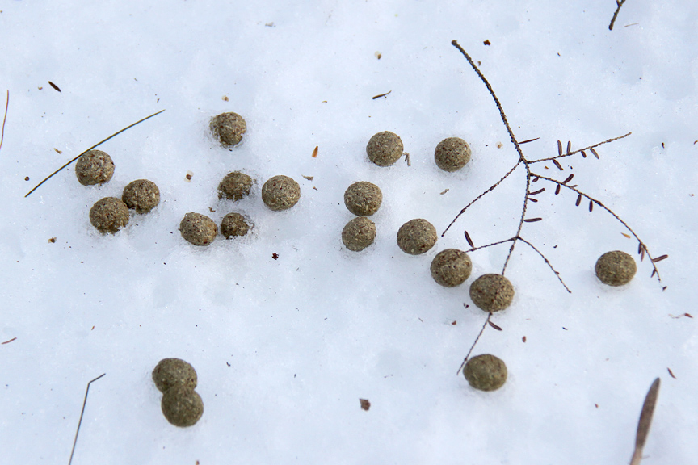
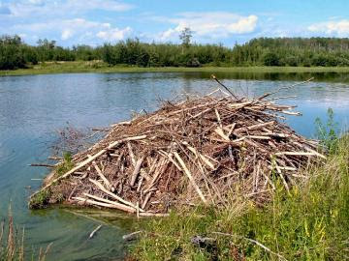
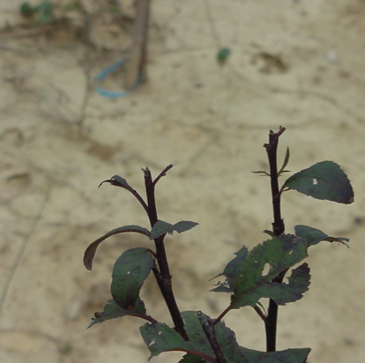
Clues: Species Signs

Slide 10
Other Things to Consider:
Abundance of Resource
Food Source, Cover Type
Are species competing for these resources?
Are special abilities necessary to reach/access these resources (Flight? A nut-cracking bill or incisors? Ability to swim? Ability to climb?)
What is the Climate of the Area?
What animals could stay here year-round? What might winter here? What might migrate through?

Slide 11
Outside Activity:
Putting our observations and knowledge to the test!

